Slide 1
Everything You Ever wanted To Know About Statistics
Prof. Andy Field

Slide 2
Aims and Objectives
Know what a statistical model is and why we use them.
The Mean
Know what the ‘fit’ of a model is and why it is important.
The Standard Deviation
Distinguish models for samples and populations
Problems with NHST and modern approaches
Reporting Confidence intervals and effect sizes.

Slide 3
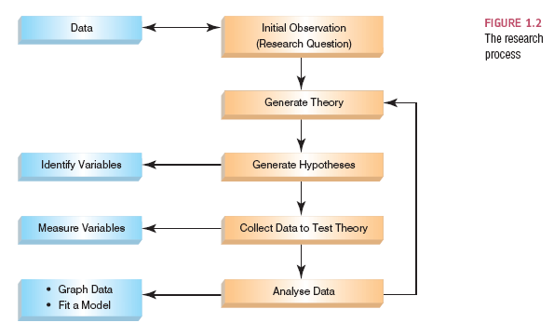
The Research Process

Slide 4
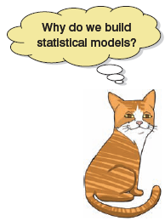
Building Statistical Models

Slide 5
Populations and Samples
Population
The collection of units (be they people, plankton, plants, cities, suicidal authors, etc.) to which we want to generalize a set of findings or a statistical model.
Sample
A smaller (but hopefully representative) collection of units from a population used to determine truths about that population

Slide 6
The Only Equation You Will Ever Need

Slide 7
A Simple Statistical Model
In Statistics we fit models to our data (i.e. we use a statistical model to represent what is happening in the real world).
The mean is a hypothetical value (i.e. it doesn’t have to be a value that actually exists in the data set).
As such, the mean is simple statistical model.
Notes:
One of the simplest models we use in statistics is the mean. Some of you may have trouble thinking of the mean as a model, but in fact it is because it represents a summary of data. The mean is a hypothetical value that can be calculated for any data set, it doesn’t have to be a value that is actually observed in the data set. For example, if we took five statistics lecturers and measured the number of friends that they had, we might find the following data: 1, 3, 4, 3, 2. If we take the mean number of friends, this can be calculated by adding the values we obtained, and dividing by the number of values measured:. Now, we know that it is impossible to have 2.6 friends (unless you chop someone up with a chainsaw and befriend part of their remains, which in practice has proved disturbing) so the mean value is a hypothetical value. As such, the mean is a model that we create to summarise our data.

Slide 8
The Mean
The mean is the value from which the (squared) scores deviate least (it has the least error).

Slide 9
The Mean as a Model

Slide 10
Measuring the ‘Fit’ of the Model
The mean is a model of what happens in the real world: the typical score
It is not a perfect representation of the data
How can we assess how well the mean represents reality?

Slide 11
A Perfect Fit
Rating (out of 5)
Rater

Slide 12
Calculating ‘Error’
A deviation is the difference between the mean and an actual data point.
Deviations can be calculated by taking each score and subtracting the mean from it:

Slide 14
Use the Total Error?
We could just take the error between the mean and the data and add them.
Score | Mean | Deviation
1 | 2.6 | -1.6
2 | 2.6 | -0.6
3 | 2.6 | 0.4
3 | 2.6 | 0.4
4 | 2.6 | 1.4
 | Total = | 0

Slide 15
Sum of Squared Errors
We could add the deviations to find out the total error.
Deviations cancel out because some are positive and others negative.
Therefore, we square each deviation.
If we add these squared deviations we get the Sum of Squared Errors (SS).

Slide 16
Score | Mean | Deviation | Squared Deviation
1 | 2.6 | -1.6 | 2.56
2 | 2.6 | -0.6 | 0.36
3 | 2.6 | 0.4 | 0.16
3 | 2.6 | 0.4 | 0.16
4 | 2.6 | 1.4 | 1.96
 |  | Total | 5.20

Slide 17
Mean squared Error
Although the SS is a good measure of the accuracy of our model, it depends on the amount of data collected. To overcome this problem, we use:

Slide 18

Degrees of Freedom
Sample
Population
11
7
8
8
12
15
?
9

Slide 19
The Standard Error
SD tells us how well the mean represents the sample data.
But, if we want to estimare this parameter in the population, then we need to

Slide 20
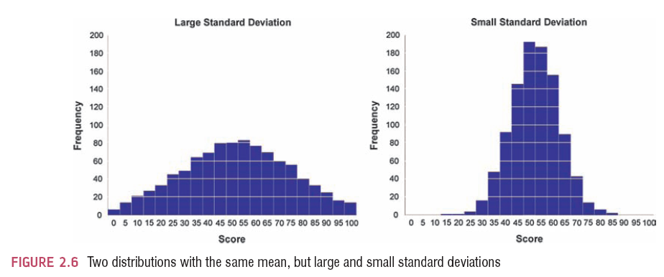
The SD and the Shape of a Distribution

Slide 21
Samples Vs. Populations
Sample
Mean and SD describe only the sample from which they were calculated.
Population
Mean and SD are intended to describe the entire population (very rare in Psychology).
Sample to Population:
Mean and SD are obtained from a sample, but are used to estimate the mean and SD of the population (very common in psychology).

Slide 22
Sampling Variation

Slide 23
Population
μ = 10
M = 10
M = 9
M = 11
M = 10
M = 9
M = 8
M = 12
M = 10
M = 11

Slide 24
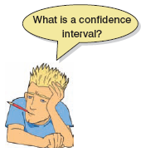
Confidence Intervals
Domjan et al. (1998)
‘Conditioned’ sperm release in Japanese Quail.
True Mean
15 Million sperm
Sample Mean
17 Million sperm
Interval estimate
12 to 22 million (contains true value)
16 to 18 million (misses true value)
CIs constructed such that 95% contain the true value.

Slide 26
Showing Confidence Intervals Visually

Slide 27
Types of Hypotheses
Null hypothesis, H0
There is no effect.
E.g. Big Brother contestants and members of the public will not differ in their scores on personality disorder questionnaires
The alternative hypothesis, H1
AKA the experimental hypothesis
E.g. Big Brother contestants will score higher on personality disorder questionnaires than members of the public

Slide 28
Test Statistics
A Statistic for which the frequency of particular values is known.
Observed values can be used to test hypotheses.

Slide 29
What does Statistical Significance (NHST) Tell Us?
The importance of an effect?
No, significance depends on sample size.
That the null hypothesis is false?
No, it is always false.
That the null hypothesis is true?
No, it is never true.
Another problem with NHST is that it encourages all or nothing thinking.

Slide 30
One- and Two-Tailed Tests

Slide 31
Type I and Type II Errors
Type I error
occurs when we believe that there is a genuine effect in our population, when in fact there isn’t.
The probability is the α-level (usually .05)
Type II error
occurs when we believe that there is no effect in the population when, in reality, there is.
The probability is the β-level (often .2)

Slide 32
Confidence Intervals and Statistical Significance

Slide 33
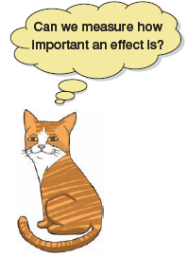
Effect Sizes
An effect size is a standardized measure of the size of an effect:
Standardized = comparable across studies
Not (as) reliant on the sample size
Allows people to objectively evaluate the size of observed effect.

Slide 34
Effect Size Measures
There are several effect size measures that can be used:
Cohen’s d
Pearson’s r
Glass’ Δ
Hedges’ g
Odds Ratio/Risk rates
Pearson’s r is a good intuitive measure
Oh, apart from when group sizes are different …

Slide 35
Effect Size Measures
r = .1, d = .2 (small effect):
the effect explains 1% of the total variance.
r = .3, d = .5 (medium effect):
the effect accounts for 9% of the total variance.
r = .5, d = .8 (large effect):
the effect accounts for 25% of the variance.
Beware of these ‘canned’ effect sizes though:
The size of effect should be placed within the research context.

